Slide 1

Gotham
Keynote - Will drive you through the changes!
T-DIT-700 MSc2020
Gotham T-DIT-700

Slide 2
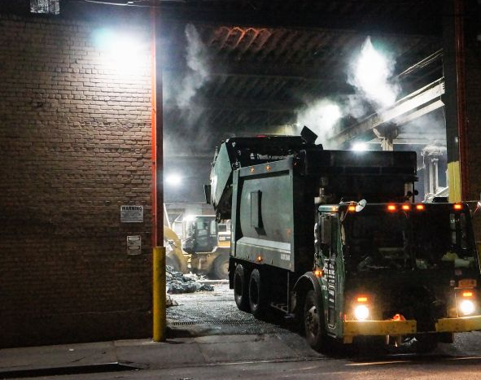
Summary 1. Introduction 2. Global Changes 3. Phase 1 : Inventory of changes 4. Phase 2 : Communication and training 5. Phase 3 : Get feedback and action plan 6. Financial Plan 7. Conclusion

Slide 3

Introduction
Overview of all the changes implemented by the townhall

Slide 4








Global Changes
1- Use the working time app
2- Equip trucks with GPS
3 – Equip employees with electronic device
4 - Use drones to check the collections and the state of cleanliness of the streets
5 – Smart trashes, with sensor
6 – Public app for incident reporting
7 – Monthly performance reporting

Slide 5
Change management
The benefits :
Assess and understand the need and the impact of change.
Align resources within the business to support the change
Reduce the time needed to implement change
Support staff and help them understand the change process
Plan and execute an effective communication strategy
Minimise resistance to change
Reduce stress and anxiety associated with change
Minimise the possibility of change failure
...

Slide 6
Phase 1
Inventory of changes
initial diagnosis

Slide 7
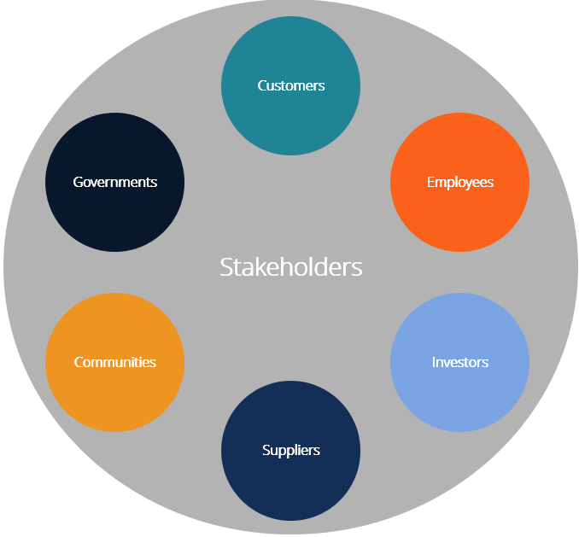
Stakeholder
Identify all the stakeholders in the project

Slide 8
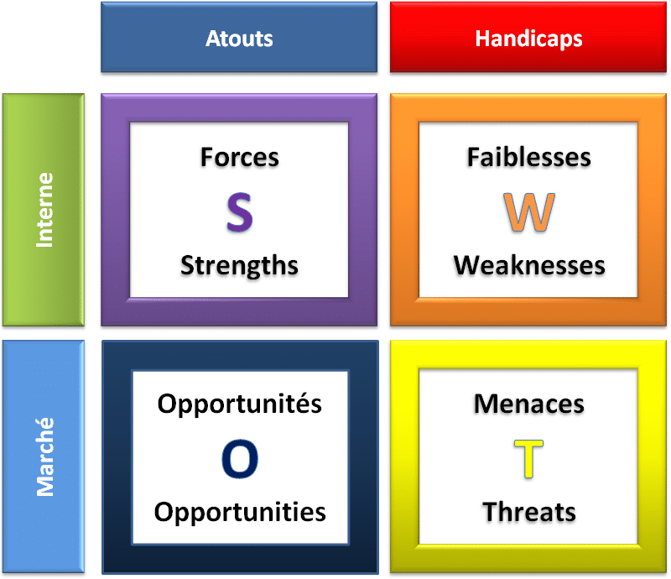
SWOTT
It is a source of information for strategic planning.
Builds organization’s strengths.
Reverse its weaknesses.
Maximize its response to opportunities.
It helps in identifying core competencies of the firm.
It helps in setting of objectives for strategic planning.
It helps in knowing past, present and future so that by using past and current data, future plans can be chalked out.

Slide 9
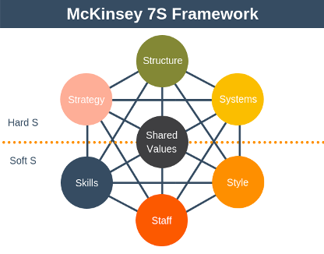
Mc Kinsey Model
5 steps :
Understand the current situation.
Determine the situation
Determine your action plan to reach the desired situation
Execute the action plan
Perform a periodic review of the situation

Slide 10
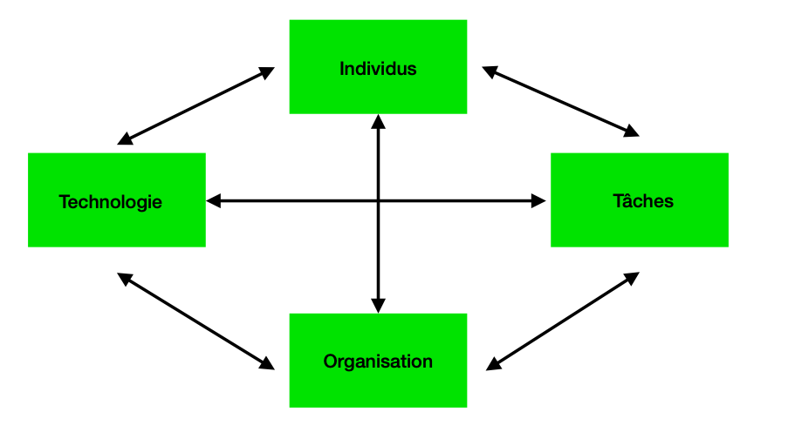
Leavitt diamond
Used to analyze the impact of a change in one of the components.

Slide 11

Gantt
Clear representation of project tasks
Effective time management
Better resource allocation

Slide 12
Phase 2
Communication And Training

Slide 13

Change management
Communication :
To circulate the right information at the right time
To facilitate management, and decision making
To include all employees in the change by answering their questions and listening to their recommendation as expert in their profession.

Slide 14

Change management
Training :
Help employee feel comfortable with the changes taking place
Have all the necessary knowledge to participate in innovation

Slide 15
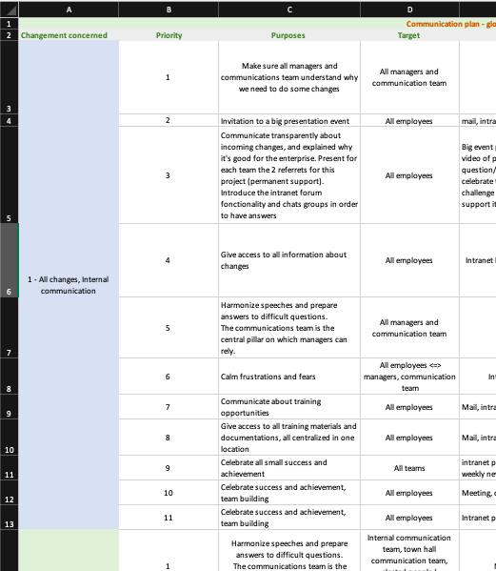
Plan everything
Training plan and communication plan :
Plan in advance as much communication and training element as possible, to leave time for the unexpected.
Use these plans as a guideline, to stay the course.

Slide 16
Phase 3
Get Feedback and Action plan

Slide 17
Get feedback
Understand the current situation.
Get the feeling of the people affected by change in order to develop corrective action plans.
Implement actions that strengthen the adoption the situation
We use the ADKAR form template to collect individual feedback, it covers all areas affected by a change

Slide 18
Action plan
After analyzing the metrics and feedbacks, we must set up action plans to :
Reinforcing the change adoption
Correct the course if the objectives are not reached

Slide 19
Celebrate success
To encourage teams and congratulate them, we must celebrate success, it allows to :
Strengthen support for change
Boost team moral after a difficult period of change

Slide 20
Financial Plan

Slide 21

Financial plan
Backed by Wayne Company funds, all costs are covered.
We also have a supplement to deal with unforeseen events

Slide 22
Conclusion
During this project we saw all the necessary steps for the success of a large-scale project and the importance of change management.
We used discord, Microsoft teams and shared documents to facilitate exchanges within the team

Slide 23

Thank you for listening
Do you have questions ?

